Slide 1




NEXT GEN EMPLOYABILITY PROGRAM
Creating a future-ready workforce
Team Members
College Name
Student Name :Mohamed Arsath A A
Student ID :autjpcoelecs01
JP College Of Engineering

Slide 2

CAPSTONE PROJECT SHOWCASE
Project Title
Voting Web Application using Django Framework
Abstract | Problem Statement | Project Overview | Proposed Solution | Technology Used | Modelling & Results | Conclusion

Slide 3
Abstract
The Voting Application built on the Django framework is a web-based platform designed to facilitate secure and efficient voting processes for various contexts, including elections, surveys, and decision-making. Leveraging Django's robust features, such as authentication, database management, and dynamic URL routing, the application ensures scalability, reliability, and ease of maintenance Key features of the Voting Application include user authentication and authorization mechanisms to safeguard the integrity of the voting process and protect sensitive data. Administrators can easily create, manage, and customize voting events, define candidate lists, and set voting parameters through an intuitive administrative interface Voters access the platform via personalized dashboards upon authentication, where they can view available voting events, cast their votes securely, and receive confirmation of their submissions. The application employs encryption techniques to protect voter anonymity and confidentiality, mitigating potential security risks and ensuring trustworthiness.

Slide 4
Problem Statement
Security and Integrity: Ensuring the security and integrity of the voting process is paramount to prevent tampering, fraud, or unauthorized access to sensitive data. The application must implement robust authentication mechanisms, encryption techniques, and access controls to safeguard voter information and maintain trust in the system.
User Experience: The voting platform must offer a seamless and intuitive user experience for both administrators and voters. User-friendly interfaces, clear instructions, and accessibility features are essential to encourage participation and engagement among diverse user demographics, including those with limited technical proficiency or disabilities
ransparency and Accountability: Transparency in the voting process is essential to build trust and confidence among participants and stakeholders. The application should provide real-time result tabulation, audit trails, and comprehensive reporting tools to enable transparent monitoring and analysis of voting outcomes.

Slide 5
Project Overview
The project aims to develop a sophisticated web-based voting application leveraging the Django framework, designed to facilitate digital polls, surveys, or elections for organizations, institutions, or communities.
With a focus on user engagement and transparency, the application's key features include robust user authentication and registration functionalities, ensuring secure access to the voting platform.
Administrators will have comprehensive control over the poll creation and management process, enabling customization of poll parameters such as titles, descriptions, and question types.
Participants will interact with an intuitive voting interface, equipped to handle various question formats and provide real-time feedback on active polls.

Slide 6
Proposed Solution
.
The proposed Voting Application will be built using the Django framework, leveraging its powerful features for rapid development, security, and scalability. The application will provide a comprehensive platform for conducting various types of elections, surveys, and decision-making processes in a transparent, efficient, and user-friendly manner.
1.Voter Interface.
2.Administrative Dashboard.
3.User Authentication and Registration.
4.Security and Data Protection.
5.Transparent and Auditable Process.
6.Scalability and Performance Optimization.
7.Reporting and Analytics.
8.Compliance and Legal Considerations.
9.Customizable Voting Events.

Slide 7
Advantages:
Rapid Development: Django's built-in features and conventions streamline the development process, allowing developers to focus on implementing the voting logic rather than boilerplate code.
Scalability: Django's scalability features, such as support for horizontal scaling and efficient database management, enable the application to handle a large number of users and concurrent voting events without sacrificing performance.
Security: Django provides robust security features out-of-the-box, including protection against common web vulnerabilities such as SQL injection, cross-site scripting (XSS), and cross-site request forgery (CSRF). Additionally, Django's authentication system and built-in user management tools make it easy to implement secure login mechanisms and access controls, ensuring the integrity and confidentiality of the voting process.

Slide 8
Disadvantages:
Complexity of Development: Developing a fully functional and secure voting application using Django requires expertise in web development, security protocols, and database management. Managing complex features such as user authentication, encryption, and real-time result tabulation may increase development time and effort.
Security Risks: Despite Django's built-in security features, the application may still be vulnerable to security risks such as SQL injection, cross-site scripting (XSS), and data breaches if not implemented and configured correctly.
Scalability Challenges: While Django is capable of handling high volumes of traffic, scaling the application to accommodate exponential growth in users or voting events may pose challenges.

Slide 9
Technology Used
Front-end
1.HTML
2.CSS
3.Java Script
4.Bootstrap
Back-end
1.Python
2.Django
3.SQL
Source :

Slide 10
Modelling & Results
Once users have participated in the voting process, conveying the results to them becomes paramount.
Through Django's model system, the application's data architecture is meticulously crafted, typically featuring models like Question and Choice to represent the polls and available choices.
In developing a voting application using Django, meticulous attention is directed towards both modeling the underlying data structure and effectively presenting the voting results to users.
Leveraging Django's templating system, the application dynamically generates HTML templates that vividly present the voting outcomes in an intuitive and visually engaging manner.
Furthermore, the application may utilize charting libraries or custom visualization techniques to elucidate the distribution of votes across different options, offering users valuable insights into the voting process's outcome.

Slide 11
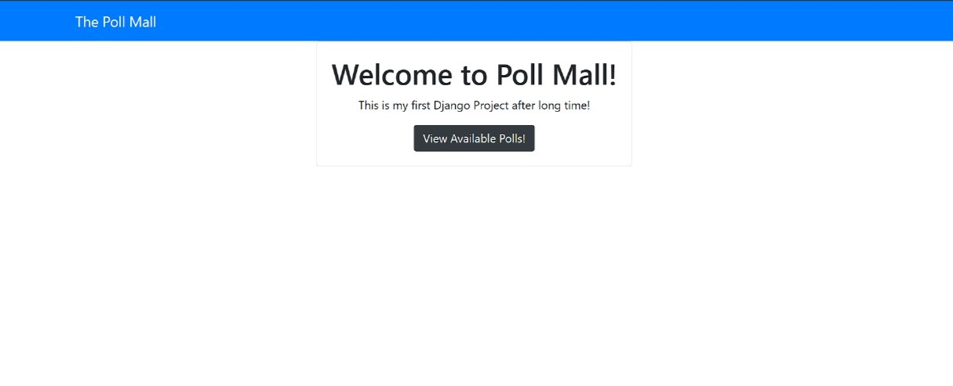
Homepage

Slide 12
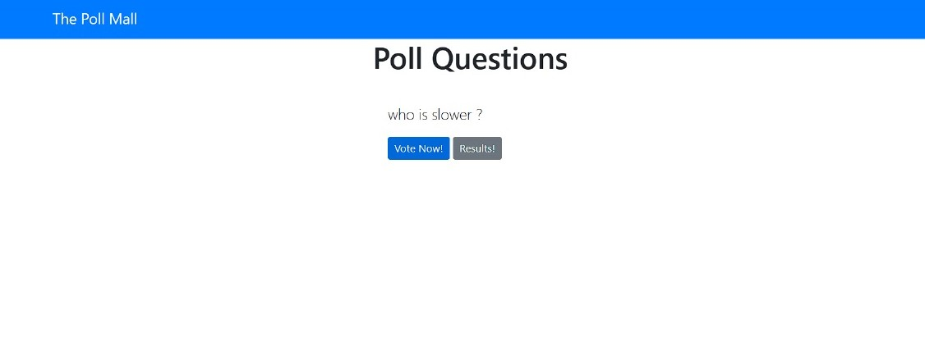
Polling Questions Page

Slide 13
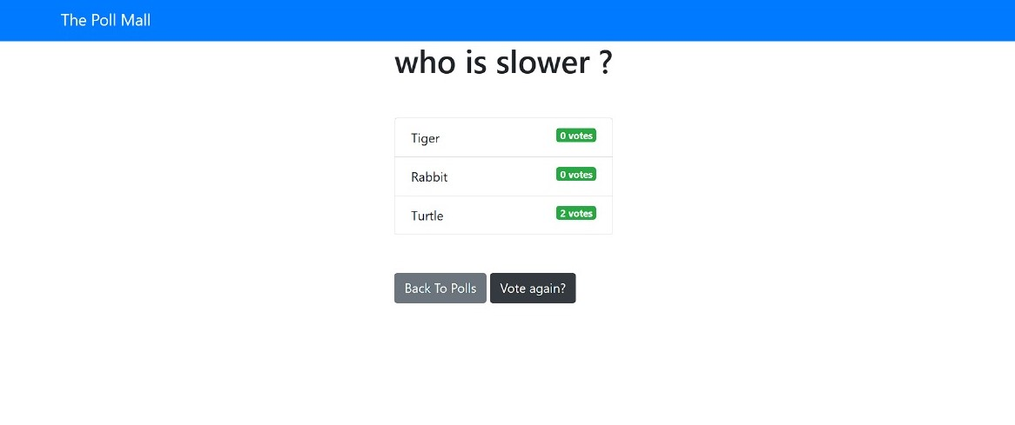
Voting Page

Slide 14
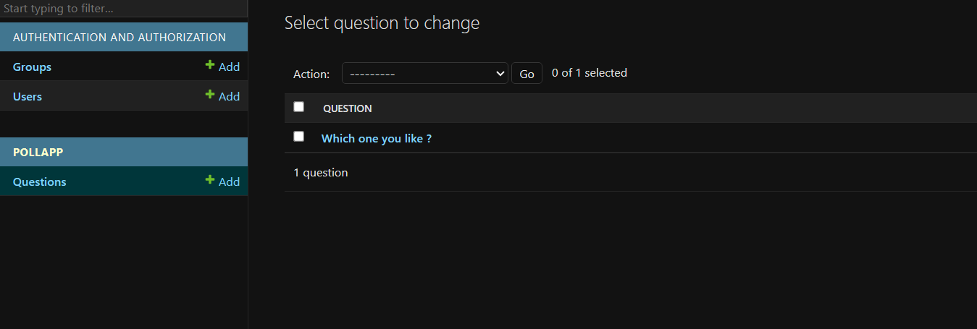
Admin-Page

Slide 15
Future Enhancements:
Real-time collaboration features offer another avenue for enhancement, empowering teams or committees to collaboratively create and refine polls, enhancing decision-making processes.
Furthermore, the incorporation of social media integration could amplify user engagement by allowing participants to share their voting activities and poll results seamlessly across popular platforms, fostering a wider reach and encouraging community involvement.
In the pursuit of advancing the voting application, several avenues for enhancement present themselves to enrich its functionality and user engagement.
One promising direction is the integration of advanced analytics tools, enabling administrators to glean deeper insights into voting behaviors, demographic trends, and predictive modeling for future electoral outcomes.

Slide 16
Conclusion
In conclusion, the development of the voting application using the Django framework has provided a solid foundation for facilitating democratic participation and decision-making processes. Through meticulous modeling of the data structure and thoughtful presentation of voting results, the application delivers a seamless and transparent user experience. However, the journey does not end here. By embracing future enhancements such as advanced analytics, social media integration, real-time collaboration, and mobile accessibility, the application can evolve to meet the evolving needs of its users and administrators. Ultimately, the voting application stands as a testament to the power of technology in fostering civic engagement, empowering individuals, and upholding the principles of democracy.
Source :

Slide 17
Thank You!
Notes:
Thank You !!

